Slide 1
CMSC201 Computer Science I for Majors Lecture 22 – Algorithmic Analysis & Hexadecimal Numbers

Slide 2
Last Class We Covered
Sorting algorithms
Bubble Sort
Selection Sort
Quicksort
Searching algorithms
Linear search
Binary search

Slide 3
Any Questions from Last Time?

Slide 4
Today’s Objectives
To learn about hexadecimal numbers
To be able to convert between bin, dec, and hex
To learn about asymptotic analysis
What it is
Why it’s important
How to calculate it
To discuss “run time” of algorithms
Why one algorithm is “better” than another

Slide 5
Hexadecimal Numbers

Slide 6
Decimal Representation
Decimal uses 10 digits
Decimal, deci = 10
The digits used are 0, 1, 2, 3, 4, 5, 6, 7, 8, and 9
hundred thousands
ten millions
ten thousands
thousands
millions
hundreds
tens
ones
9
8
7
5
4
2
1
0
10⁷
10⁶
10⁵
10⁴
10³
10²
10¹
10⁰

Slide 7
Binary Representation
Binary uses 2 digits
Binary, bi = 2
The digits used are 0 and 1
one hundred and twenty-eights
sixty-fours
thirty-twos
sixteens
eights
fours
twos
ones
1
0
0
1
1
1
1
0
2⁷
2⁶
2⁵
2⁴
2³
2²
2¹
2⁰

Slide 8
Hexadecimal Representation
Hexadecimal (or just “hex”) uses 16 digits
Hexadecimal, hex = 6 plus deci = 10 → 16
The digits used are 0, 1, 2, 3, 4, 5, 6, 7, 8, and 9
And letters A (10), B (11), C (12), D (13), E (14), and F (15)
two hundred sixty-eight million four hundred thirty-five thousand four hundred and fifty-sixes
sixty-five thousand five hundred and thirty-sixes
sixteen million seven hundred seventy-seven thousand two hundred and sixteens
one million forty-eight thousand five hundred and seventy-sixes
four thousand and ninety-sixes
two hundred and fifty-sixes
sixteens
ones
F
D
A
8
6
3
1
0
16⁷
16⁶
16⁵
16⁴
16³
16²
16¹
16⁰

Slide 9
Hexadecimal Representation
Hexadecimal (or just “hex”) uses 16 digits
Hexadecimal, hex = 6 plus deci = 10 → 16
The digits used are 0, 1, 2, 3, 4, 5, 6, 7, 8, and 9
And letters A (10), B (11), C (12), D (13), E (14), and F (15)
268435456s
16777216s
1048576s
sixteens
65536s
4096s
256s
ones
F
D
A
8
6
3
1
0
16⁷
16⁶
16⁵
16⁴
16³
16²
16¹
16⁰

Slide 10
Hex to Binary Conversion
A hexadecimal digit can be easily represented as four digits of binary (with leading zeros)
This makes conversion very simple
7A0F becomes 0111 1010 0000 1111
1100 0010 0110 1001 becomes C269
Hex | Binary | Hex | Binary | Hex | Binary | Hex | Binary
0 | 0000 | 4 | 0100 | 8 | 1000 | C | 1100
1 | 0001 | 5 | 0101 | 9 | 1001 | D | 1101
2 | 0010 | 6 | 0110 | A | 1010 | E | 1110
3 | 0011 | 7 | 0111 | B | 1011 | F | 1111

Slide 11
Hex to Decimal Conversion
Possible to convert between decimal and hex
But it requires calculating out multiples of 16
Simpler to make a “side trip” to binary as an in-between step when converting
240 becomes 1111 0000 becomes F0
F0 is equal to (15 * 16¹) + (0 * 16⁰) = 240 + 0 = 240
7D becomes 0111 1101 becomes 125
7D is equal to (7 * 16¹) + (13 * 16⁰) = 112 + 13 = 125

Slide 12
Number System Notation
Because number systems share a subset of the same digits, it may be confusing which is which
For example, what is the value of 10?
In decimal it’s 10, in binary it’s 2, and in hex it’s 16
To prevent this, numbers may often be prefixed with 0b, 0d, or 0x (binary, decimal, hex):
0b1100 is binary, and has a value of 12
0x15 is hexadecimal, and has a value of 21

Slide 13
Run Time

Slide 14
Alphabetizing a Bookshelf
Video from https://www.youtube.com/watch?v=WaNLJf8xzC4

Slide 15
Run Time
An algorithm’s run time is the amount of “time” it takes for that algorithm to run
“Time” normally means number of operations or something similar, and not seconds or minutes
Run time is shown as an expression, which updates based on how large the problem is
Run time shows how an algorithm scales, or changes with the size of the problem

Slide 16
Example: Fibonacci Recursion
Ideally, we want an algorithm that runs in a reasonable amount of time, no matter how large the problem
Remember the recursive Fibonacci program?
It runs within one second for smaller positions
But the larger the position we ask for, the longer and longer it takes

Slide 17
Fibonacci Recursion
python fibEx.py (with position < 30):
< 1 second
python fibEx.py (with position = 30):
2 seconds
python fibEx.py (with position = 35):
8 seconds
python fibEx.py (with position = 40):
76 seconds

Slide 18
Fibonacci Recursion
python fibEx.py (with position = 50):
Guess!
9,493 seconds
2 hours, 38 minutes, 13 seconds!!!

Slide 19
Run Time for Linear Search
Say we have a list that does not contain what we’re looking for.
How many things in the list does linear search have to look at for it to figure out the item’s not there for a list of 8 things?
16 things?
32 things?

Slide 20
Run Time for Binary Search
Say we have a list that does not contain what we’re looking for.
What about for binary search?
How many things does it have to look at to figure out the item’s not there for a list of 8 things?
16 things?
32 things?
Notice anything different?

Slide 21
Different Run Times
These algorithms scale differently!
Linear search does an amount of work equal to the number of items in the list
Binary search does an amount of work equal to the log₂ of the numbers in the list!
By the way, log₂(x) is basically asking “2 to what power equals x?” (normally shown as lg(x) )
This is the same as saying, “how many times must we divide x in half before we hit 1?”

Slide 22
Bubble Sort Run Time
For a list of size N, how much work do we do for a single pass?
N
How many passes will we have to do?
N
What is the run time of Bubble Sort?
N²

Slide 23
Selection Sort Run Time
What is the run time of finding the lowest number in a list?
For a list of size N, how many elements do you have to look through to find the min?
N

Slide 24
Selection Sort Run Time
For a list of size N, how many times would we have to find the min to sort the list?
N
What is the run time of this sorting algorithm?
N²

Slide 25
Quicksort Run Time
For a list of size N, how many steps does it take to move everything less than the “pivot” to the left and everything greater than the “pivot” to the right?
N

Slide 26
Quicksort Run Time
How many times will the algorithm divide the list in half?
lg(N)
What is the run time of Quicksort?
N * lg(N)

Slide 27
Different Run Times
As our list gets bigger and bigger, which of the search algorithms is faster?
Linear or binary search?
How much faster is binary search?
A lot!
But exactly how much is “a lot”?

Slide 28
Asymptotic Analysis

Slide 29
What is “Big O” Notation?
Big O notation is a concept in Computer Science
Used to describe the complexity (or performance) of an algorithm
Big O describes the worst-case scenario
Big Omega (Ω) describes the best-case
Big Theta (Θ) is used when the best and worst case scenarios are the same

Slide 30
A Simple Example
Say we write an algorithm that takes in an list of numbers and returns the maximum
What is the absolute fastest it can run?
Linear time – Ω(N)
What is the absolute slowest it can run?
Linear time – O(N)
Are these two values the same?
YES – so we can also say it’s Θ(N)

Slide 31
Simplification
We are only interested in the growth rate as an “order of magnitude”
As the problem grows really, really, really large
We are not concerned with the fine details
Constant multipliers are dropped
So O(3 * N²) becomes simply O(N²)
Lower order terms are dropped
So O(N³ + 4N²) becomes simply O(N³)

Slide 32
Asymptotic Analysis
For a list of size N, linear search does N operations. So we say it is O(N) (pronounced “big Oh of n”)
For a list of size N, binary search does lg(N) operations, so we say it is O(lg(N))
The function inside the O() parentheses indicates how fast the algorithm scales

Slide 33
Worst Case vs Best Case
Why differentiate between the two?
Think back to selection sort
What is the best case for run time?
What is the worst case for run time?
They’re the same!
Always have to find each minimum by looking through the entire list every time – Θ(N²)

Slide 34
Bubble Sort Run Times
What about bubble sort?
What is the best case for run time?
What is the worst case for run time?
Very different!
Best case, everything is already sorted – Ω( N )
Worst case, it’s completely backwards – O( N² )

Slide 35
Quicksort Run Times
What about quicksort?
Depends on what the “hinge” or “pivot” is
This determines how many times we split
But each split, we’ll need to compare each item to the hinge in their respective part: O( N )
Best case, pivot is exact center – Ω( N*lgN )
Worst case, it’s an “edge” item – O( N² )

Slide 36
Worst-case vs Best-case
This is why, even though all three sorting algorithms have same worst case run times...
Quicksort often runs very, very quickly
Bubble Sort often runs much faster than Selection
How does this apply to linear search and binary search? What are the best and worst run times for these?

Slide 37
Search Run Times
Linear search:
Best case: Ω( 1 )
Worst case: O( N )
Binary search:
Best case: Ω( 1 )
Worst case: O( lg(N) )

Slide 38
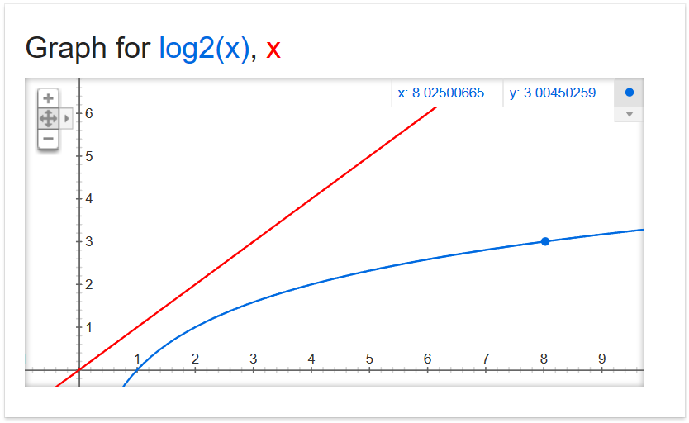
Why Care?

Slide 39
Why Care?

Slide 40
Why Care?

Slide 41
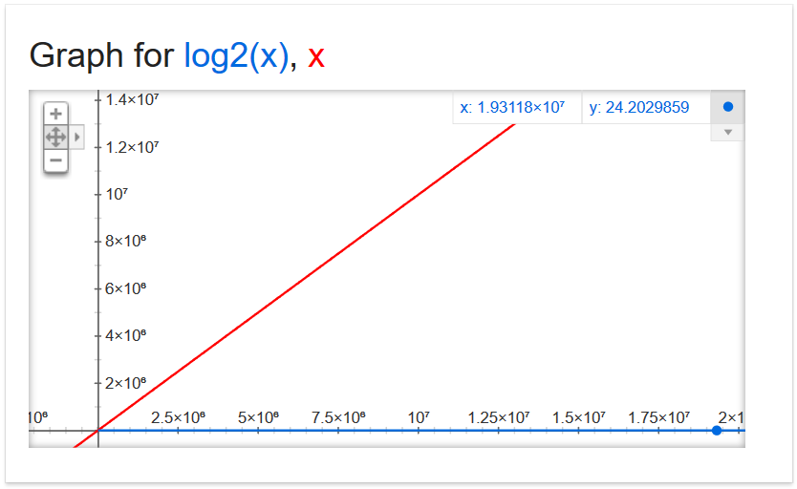
Why Care?
19,311,800

Slide 42
Why Care?
337,407,000,000,000,000

Slide 43
Why Care?
For large problems, there’s a huge difference!
If we can do 1,000,000 operations per second, and the list is 337.4 quadrillion items
Binary search takes 0.000058 seconds
Linear search takes 337,407,000,000 seconds
5,623,450,000 minutes
93,724,166 hours
3,905,173 days
10,699 years

Slide 44
Daily CS History
Hedy Lamarr
Film star in 1930s - 1950s
Patented a frequency-hopping system that would make radio-guided torpedoes hard to detect or jam during World War II
Technologies like Bluetooth and Wi-Fi use similar methods

Slide 45
Final Exam Locations
Find your room ahead of time!
Engineering 027 - Sections 2, 3, 4, 5, 6, 25
Section 22
Meyerhoff 030 - Sections 8, 9, 10, 11, 12
Sections 14, 15, 16, 17

Slide 46
Announcements
Project 3 is due on Friday, May 10th
Survey #3 is out now
Course evaluations also out, please complete
Final exam is Friday, May 17th from 6 to 8 PM

Slide 47
Image Sources
Alphabetizing a Bookshelf video screenshot:
https://www.youtube.com/watch?v=WaNLJf8xzC4
Graphs of x and log₂(x) courtesy of Google equation grapher
Hedy Lamarr:
https://commons.wikimedia.org/wiki/File:Hedy_lamarr_-_1940.jpg

